Slide 1










AC Sales Analysis Using Web Scraping ( Flipkart)
K. Hemanth
Batch : 456

Slide 2
Agenda
Business Problem
Problem statement
Web Scraping Details
Raw Data
Data Cleaning And Manipulation
Final Dataframe After Manipulation
Data Overview
Univariate Analysis
Bivariate Analysis
Hypothesis Test
Challenges
Recommendations
Conclusion

Slide 3

Business Problem
John Is A Working Professional Who Wants To Buy A New Air Conditioner. He Visits Multiple Online Platforms And Sees Hundreds Of AC Models With Different:
Prices
AC Capacity Options (Ton)
Energy Star Ratings
Brand Variations
Customer Ratings
Some Acs Cost ₹20,000, While Others Cost ₹80,000, But Many Of Them Appear To Have Similar Features.
John Starts Asking Questions:
“Is Paying More Really Worth It?”
“Should I Buy 1 Ton, 1.5 Ton Or 2 Ton AC?”
“Do Higher Energy Star Ratings Always Mean Better Customer Ratings?”
“Which Features Actually Increase The Price?”
Like John, Many Buyers Face The Same Confusion While Purchasing An Ac Online.

Slide 4
Problem Statement
Customers Face Difficulty Choosing The Best-value AC Due To Many Similar Models With Varying Prices, Brands, And Energy Ratings In Online Markets.
This Project Applies Eda On Ac Product Data To Understand How Pricing, Discounts, Capacity, Energy Efficiency, And Customer Ratings Influence Purchase Decisions.
By Identifying Key Patterns And Insights, This Study Helps In:
Understanding How Price Varies With Capacity, Brand, And Star Rating.
Finding Which Factors Contribute Most To Higher Prices.
Checking Whether Expensive Products Are Actually Better Rated.
Highlighting The Best Value Combinations For Customers.
Ultimately, The Objective Is To Support Customers In Making Smarter Ac Purchase Decisions Using Data-driven Insights.

Slide 5
Web Scraping – Details
Website : Flipkart.com
Tools Used : Selenium Web Driver, Python, Locators, And Regex.
Approach : Inspecting The Website > Install Selenium > Opens Target URL > Locate Elements > Extract The Data Using Regex > Clean The Data > Store The Data.
Saved To Structured Data Frame For EDA Analysis.

Slide 6
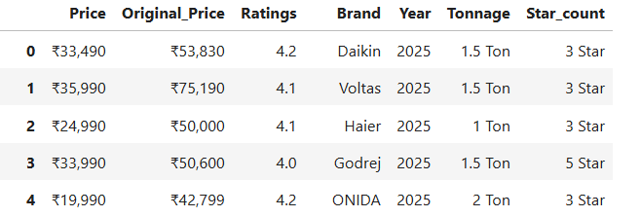
RAW DATA
This dataset was collected by scraping e-commerce website and includes AC prices, ratings, brands, capacity, year, and energy star ratings.

Slide 7
Data Cleaning And Manipulation
Handled Missing Values Using Mean/Median For Numerical Columns And Mode For Categorical Columns.
Removed Duplicate Records To Avoid Biased Analysis.
Corrected Data Types (E.G., Price To Numeric, Dates To Datetime).
Renamed Columns And Fixed Inconsistencies For Better Readability And Analysis.
Created Discount-related Features.
Applied Conditional Updates.
Prepared Data For Visualization & Insights.

Slide 8
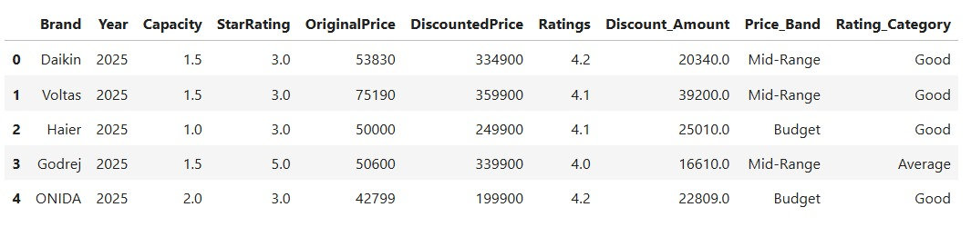
Final Dataframe After Manipulation
This final dataframe shows the cleaned and processed AC data, including prices, discounts, ratings, capacity, star ratings, and categorized price and rating bands.

Slide 9
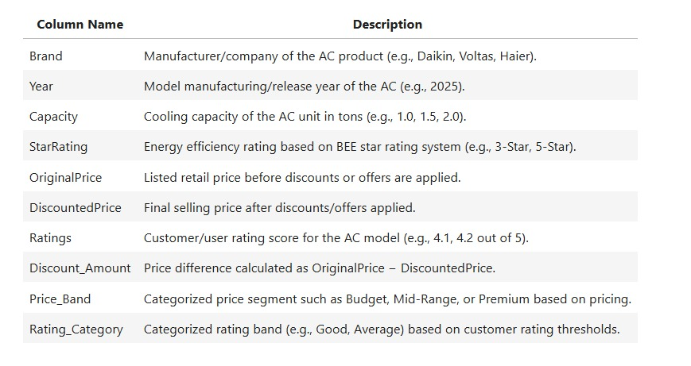
Data Overview

Slide 10
Univariate Analysis
Brand Distributions
Original Price Distributions
Discount Price Distributions
Ac Capacity Count
Star Rating Distributions

Slide 11
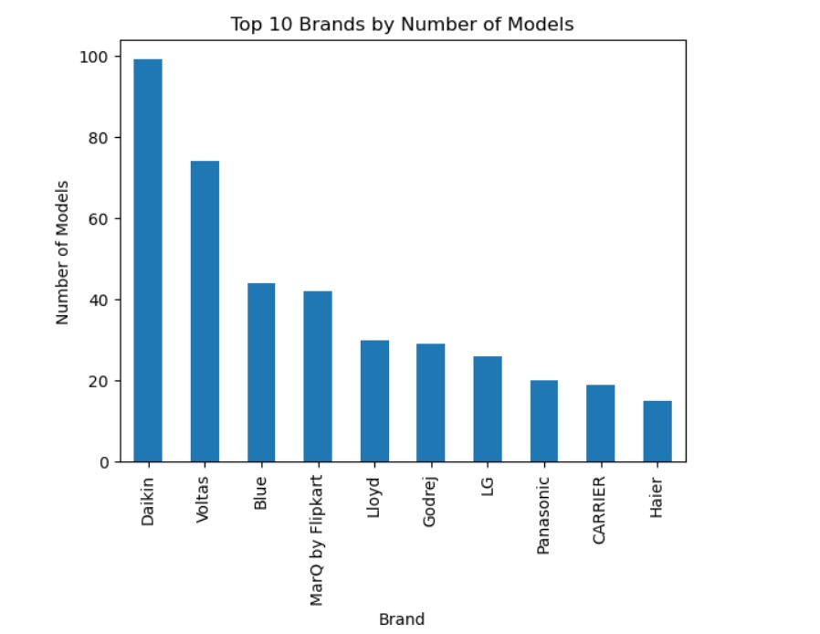
Brand Distributions :
Key Insights :
Brands like Daikin and Voltas dominate listings.
High model count suggests strong market presence.
Smaller brands compete with fewer SKUs.

Slide 12
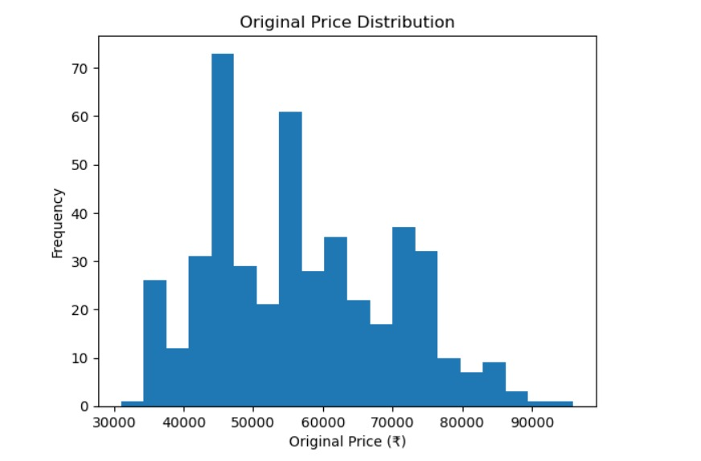
Original Price Distributions :
Key Insights :
Original Prices Are Spread Across A Wider Range.
Peaks Around ₹45k–₹60k.
Highlights The Role Of Heavy Discounting Strategies.

Slide 13
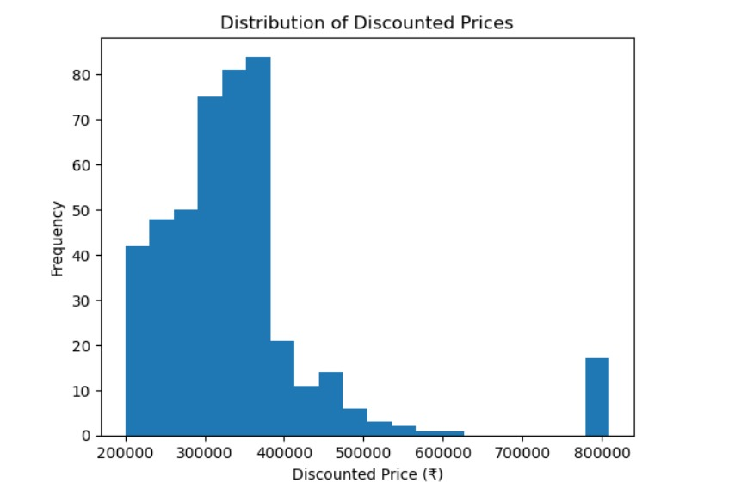
Discount Price Distributions :
Key Insights :
Most ACs are priced between ₹25,000 and ₹40,000.
The distribution is right-skewed, indicating fewer premium models.
The market is largely budget-to-mid range focused.

Slide 14
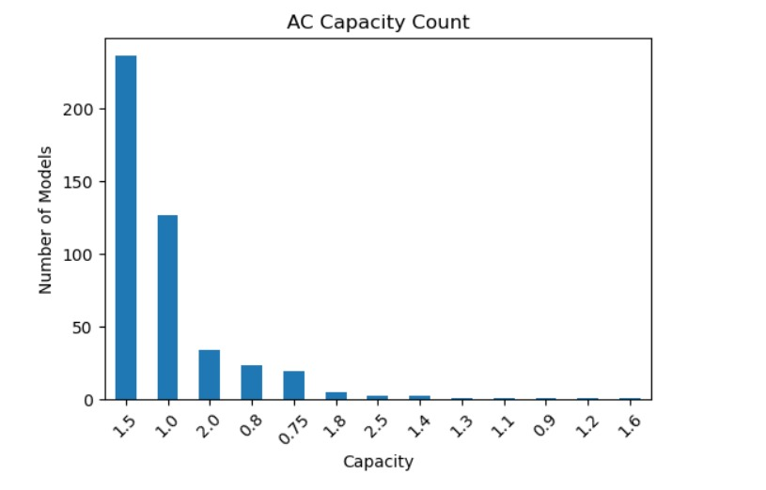
AC Capacity Count :
Key Insight :
1.5 Ton Acs Dominate The Dataset, Indicating The Highest Demand For Medium-sized Room Cooling.
1 Ton Models Are The Second Most Common, Preferred For Smaller Rooms.
Higher And Uncommon Capacities Appear Far Less Frequently, Suggesting Niche Market Demand.
Overall Capacity Distribution Reflects Typical Residential Usage Patterns.

Slide 15
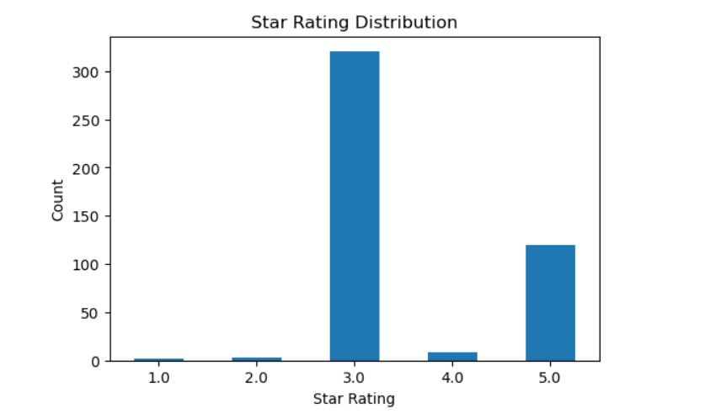
Star Rating Distributions :
Key Insights :
3-star Acs Dominate The Market.
Energy Efficiency Is Not The Top Priority For Most Buyers.
Cost Likely Outweighs Long-term Power Savings.

Slide 16
BI Variate Analysis
Discounted Price And Price Band.
Price Band And Rating Category.
Ratings And Capacity.
Discounted Price And Customer Ratings.

Slide 17
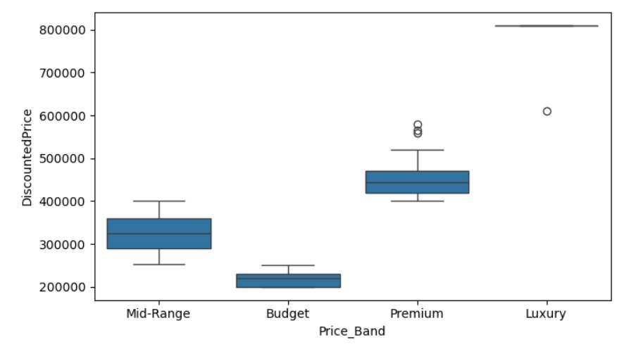
Discounted Price And Price Band :
Key Insights:
Clear Separation Is Visible Across Price Bands: Budget Has The Lowest Discounted Prices, While Premium And Luxury Have Much Higher Prices.
Luxury Band Shows Very High Prices With Minimal Variation, Indicating Only A Few High-end Ac Models Fall Under This Category.

Slide 18
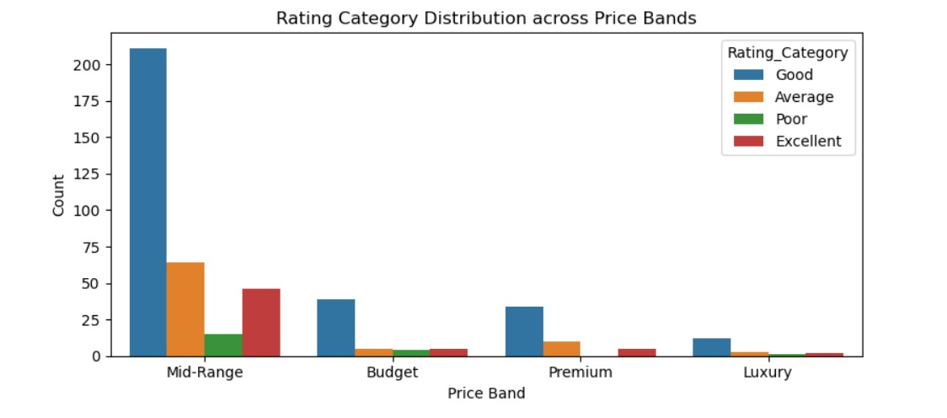
Price Band And Rating Category :
Key Insights:
Mid-range Acs Dominate The Dataset And They Mostly Fall Under The “Good” Rating Category, Indicating Most Products Are Reasonably Rated.
Premium And Luxury Bands Have Fewer Products, But They Still Show A Mix Of Rating Categories—higher Price Does Not Always Guarantee “Excellent” Ratings.

Slide 19
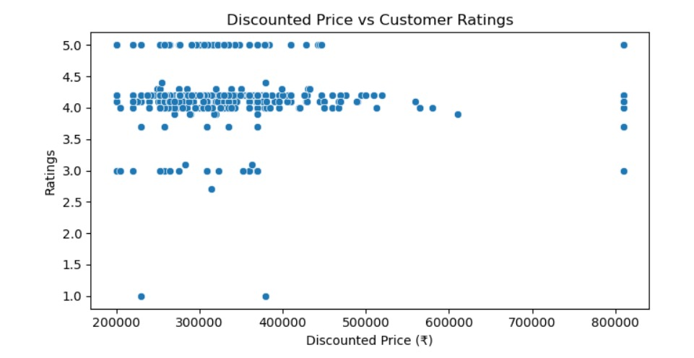
Discounted Price And Customer Ratings :
Key Insights :
Customer Ratings Stay Mostly Between 4.0–4.5 Across All Price Ranges, Showing Consistent Satisfaction.
There Is No Clear Relationship Between Discounted Price And Ratings, Meaning Higher Price Does Not Guarantee Higher Rating.

Slide 20
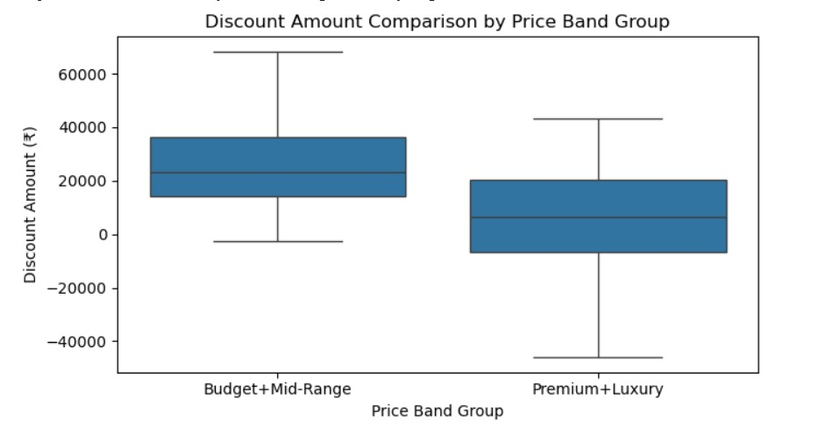
Hypothesis Test 1
WHY Hypothesis Comes After Visualization?
Because Visuals Tell Us What Looks True.
Statistics Tell Us Whether It Is Actually True.
Do Premium + Luxury ACs have higher discount amounts than Budget + Mid-Range ACs?
H0 (Null): Mean discount amount of Budget + Mid-Range ACs = Mean discount amount of Premium + Luxury Acs
H1 (Alternative): Mean discount amount of Premium + Luxury ACs > Mean discount amount of Budget + Mid-Range ACs
Key Insights :
Budget + Mid-range Acs Show Higher Discount Amounts Than Premium + Luxury Acs, Indicating Larger Discounts Are More Common In Lower And Mid-price Segments.
This Suggests That Discounts Are Used As A Strategy To Boost Sales In Budget/Mid-range Categories, While Premium Models Have Comparatively Smaller Discount Offers.

Slide 21
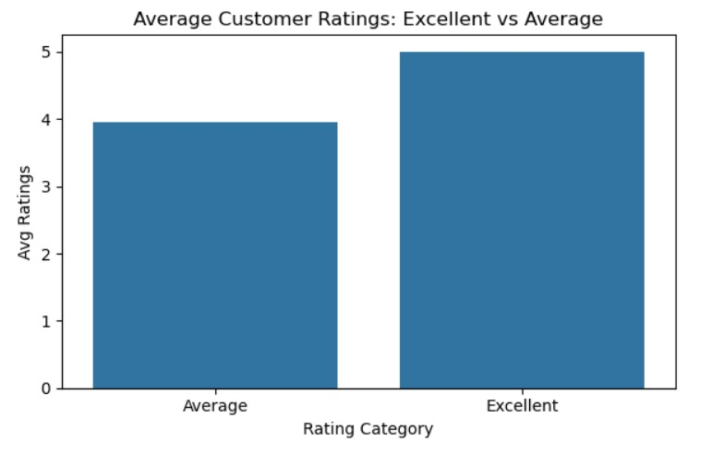
Hypothesis Test 2
Do Excellent Category Acs Have Higher Customer Ratings Than Average Category Acs?
H0 (Null): Mean Ratings Of Average Category Acs = Mean Ratings Of Excellent Category Acs.
H1 (Alternative): Mean Ratings Of Excellent Category Acs > Mean Ratings Of Average Category Acs.
Key Insights :
Excellent Category Acs Have Significantly Higher Customer Ratings Than Average Category Acs (Reject H0).
This Confirms That The Rating Category Classification Is Meaningful And Reflects Real Differences In Customer Satisfaction.

Slide 22
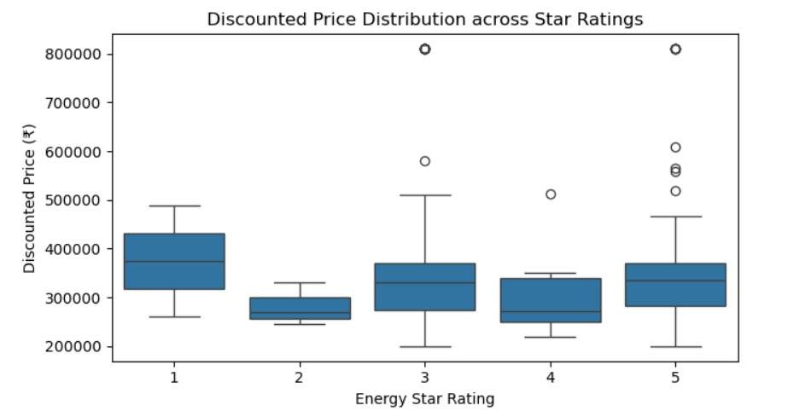
Hypothesis Test 3
Does Discounted Price differ significantly across different Energy Star Ratings (1 to 5)?
H0 (Null): Mean Discounted Price is same for all Star Ratings (1,2,3,4,5)
H1 (Alternative): At least one Star Rating group has a significantly different mean Discounted Price
Key Insights :
Discounted Price Does Not Vary Significantly Across Different Energy Star Ratings (1–5) (Fail To Reject H0).
This Indicates That Energy Efficiency (Star Rating) Is Not A Major Factor Affecting Discounted Price, And Price Is Likely Influenced More By Brand, Capacity, And Discounts.

Slide 23
Challenges
Inconsistent Price Formats (₹ Symbol And Commas) Requiring Conversion To Numeric Values.
Categorical Variations In Brand Names And Ratings Affecting Grouping And Aggregation.
Limited Historical Data With Most Records Belonging To A Single Year.
Uneven Distribution Of Tonnage Categories, Leading To Biased Comparisons.
Customer Ratings Subject To Bias, Not Always Reflecting Actual Product Performance.
Discount Influence On Price Analysis, Making True Cost Comparison Challenging.

Slide 24
Recommendations
For a Buyer Like John :
Prefer Mid-range Models For Best Value-for-money.
Compare Discount Amount, Not Just Final Price.
Premium Acs Can Be Worth Buying During Offers Due To Higher Discounts.
Choose Capacity Based On Room Requirement, Not Based Only On Price.
Star Rating Is More Useful For Electricity Savings, Not Price Prediction.

Slide 25
CONCLUSION
What We Observed (Overall Market Behavior) :
AC Prices Are Not Uniform, They Vary Significantly Across Brands, Capacity, And Price Bands.
The Price Distribution Is Right-skewed, Meaning A Small Number Of Acs Are Extremely Expensive (Premium/Luxury Models).
Mid-range Acs Dominate The Market, Indicating Most Consumers Prefer Balanced Value Options.
Customer Ratings Remain Mostly Consistent Across Price Ranges, Meaning Expensive Acs Are Not Always Rated Higher.
Energy Star Rating Does Not Significantly Change Discounted Prices, Suggesting Price Is Influenced More By Brand And Features Than Energy Efficiency.

Slide 26



